Slide 1
Data Structure and Algorithms Complexity of Algorithms

Slide 2
Algorithm
An Algorithm is any well-defined computational procedure that takes some values or set of values as input and produces some values or set of values as output.
An Algorithm is a well defined list of steps to solve a particular problem.

Slide 3
NOTION OF ALGORITHM
problem
algorithm
“computer”
input
output
Algorithmic solution

Slide 4
Suppose computers were infinitely fast and computer memory are free.
Is there any reason to study algorithm ?

Slide 5
Yes
– Demonstrate that solution, methods and so with correct answer.
If computers were infinitely fast, any correct method for solving a problem would do.
You would probably want your implementation to be within the bounds of good software engineering practice.

Slide 6
In reality
Computers may be fast, but they are not infinitely fast and Memory may be cheap but it is not free.
Computing time is therefore a bounded resource and so is the space in memory

Slide 7
Complexity
Algorithmic complexity is concerned about how fast or slow particular algorithm performs.
We define complexity as a numerical function T(n) - time versus the input size n.
Such an analysis is independent of machine type, programming style, etc.

Slide 8
Complexity
In general, we are not so much interested in the time and space complexity for small inputs.
For example, while the difference in time complexity between linear and binary search is meaningless for a sequence with n = 10, it is gigantic for n=2³⁰.

Slide 9
Complexity
For example, let us assume two algorithms A and B that solve the same class of problems P.
The time complexity of A is 5,000 n, the one for
B is [1.1^{n}] for an input with n elements.
For n = 10, A requires 50,000 steps, but B only
3, so B seems to be superior to A.
For n = 1000, however, A requires 5,000,000
steps, while B requires 2.5*10⁴¹ steps.

Slide 10
Complexity
Comparison: Time complexity of algorithms A &B.
Input Size | Algorithm A | Algorithm B
n | 5,000n | [1.1^{n}]
10 | 50,000 | 3
100 | 500,000 | 13,781
1,000 | 5,000,000 | 2.5*10⁴¹
1,000,000 | 5.10⁹ | 4.8*10⁴¹

Slide 11
Complexity
This means that algorithm B cannot be used for large inputs, while algorithm A is still feasible.
So what is important is the growth of the complexity functions.
The growth of time and space complexity with increasing input size n is a suitable measure for the comparison of algorithms.

Slide 12
Growth Function
The order of growth/rate of growth of the running time of an algorithm gives a simple characterization of the algorithm efficiency and allow us to compare the relative performance of alternative algorithm

Slide 13
Asymptotic Efficiency Algorithm
When the input size is large enough so that the rate of growth/order of growth of the running time is relevant.
Usually, an algorithm that is asymptotically more efficient will be the best choice for all but not very small inputs.

Slide 14
Asymptotic Notation
Asymptotic notations are convenient for describing the worst-case running time function T(n), which is defined only on integer input size.
Let n be a non-negative integer representing the size of the input to an algorithm

Slide 15
Asymptotic Notation
Let f(n) and g(n) be two positive functions, representing the number of basic calculations (operations, instructions) that an algorithm takes (or the number of memory words an algorithm needs).

Slide 16
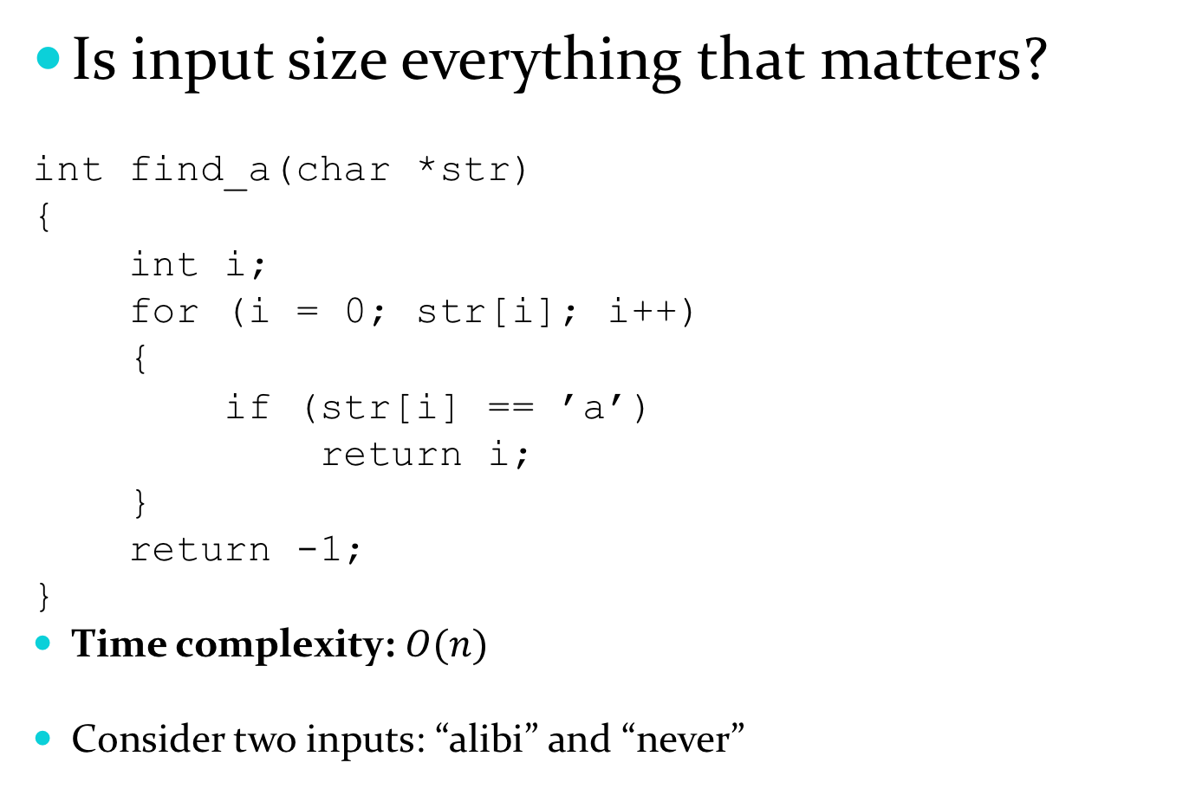
Is input size everything that matters?
int find_a(char *str)
{
int i;
for (i = 0; str[i]; i++)
{
if (str[i] == ’a’)
return i;
}
return -1;
}
Time complexity: $O(n)$
Consider two inputs: “alibi” and “never”

Slide 17
Time for an algorithm to run T(n)
A function of input. However, we will attempt to characterize this by the size of the input. We will try and estimate the WORST CASE, and sometimes the BEST CASE, and very rarely the AVERAGE CASE.
Worst Case: is the maximum run time
Best Case: minimum run time
Average Case: It is the average run time.
We can measure this three using different function.

Slide 18
Asymptotic Notation
O – Big O
Ω - Big Omega
Θ - Big Theta

Slide 19
Types of Analysis
Worst-case: (usually done)
upper bound on running time
maximum running time of algorithm on any input of size n
Average-case: (sometimes done)
we take all possible inputs and calculate computing time for all of the inputs
sum all the calculated values and divide the sum by total number of inputs
we must know (or predict) distribution of cases
Best-case: (bogus)
lower bound on running time of an algorithm
minimum running time of algorithm on any input of size n

Slide 20
O-Notation
For a given function g(n)
O (g(n)) = {f(n) : there exist positive constants c and n₀ such that 0 ≤ f(n) ≤ c g(n) for all n ≥n₀ }
Intuitively: Set of all functions whose rate of
growth is the same as or lower than that of c.g(n)

Slide 21
Ω- Notation
For a given function g(n)
Ω(g(n)) = {f(n) : there exist positive constants c and n₀ such that 0 ≤ c g(n) ≤ f(n) for all n ≥ n0}
Intuitively: Set of all functions whose rate of growth is the same as or higher than that of g(n).

Slide 22
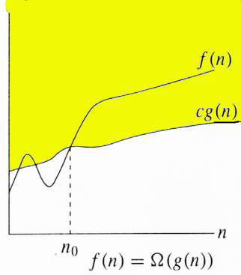
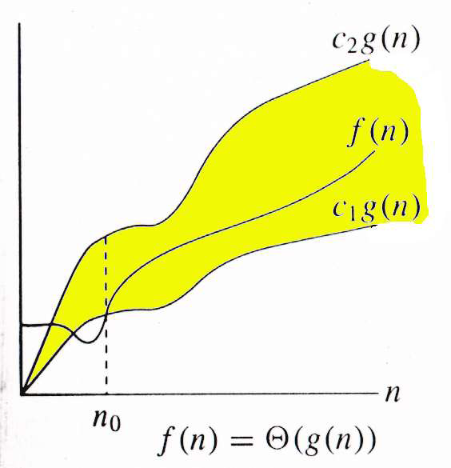
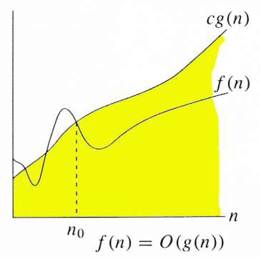
Relations Between Θ, O, Ω

Slide 23
Relations Between Θ, O, Ω
For any two function f(n) and g(n),
we have f(n) = Θ(g(n)) if and only
if f(n) = O(g(n)) and f(n) =Ω(g(n))
That is
Θ(g(n)) = O(g(n)) ∩ Ω (g(n))

Slide 24
Asymptotic Upper Bound
Example:
Show that f(x) = x² + 2x + 1 is O(x²).
For x > 1 we have:
x² + 2x + 1 ≤ x² + 2x² + x²
⇒ x² + 2x + 1 ≤ 4x²
Therefore, for C = 4 and k = 1:
f(x) ≤ Cx² whenever x > k.
⇒ f(x) is O(x²).

Slide 25
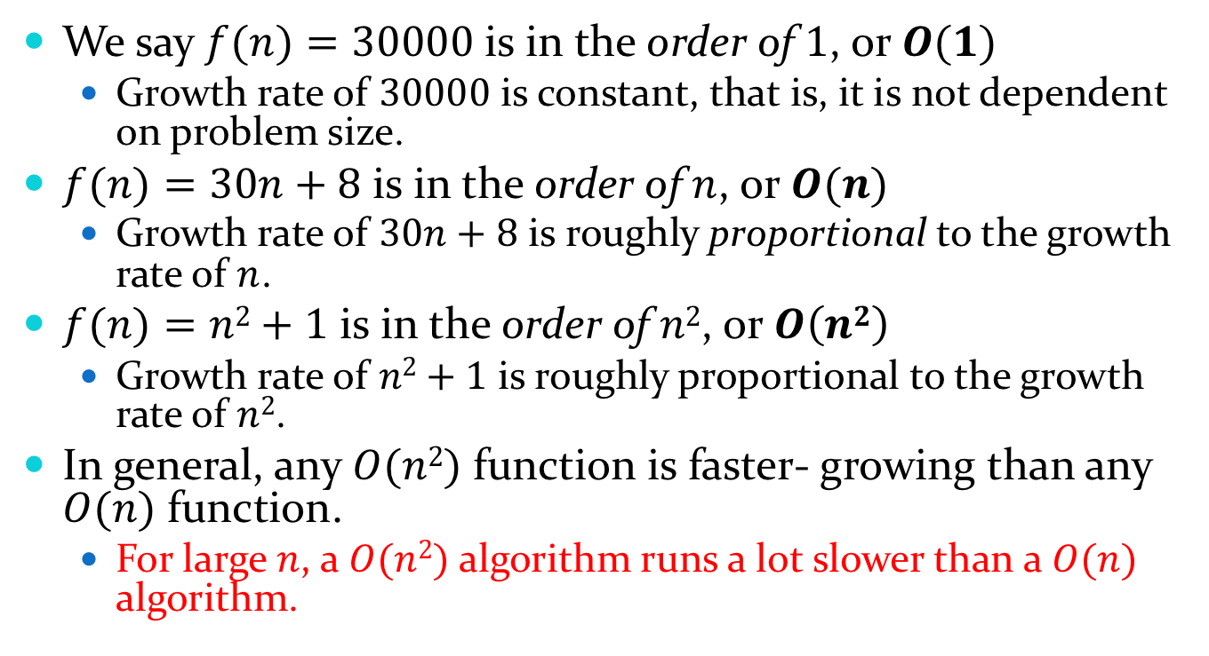
Asymptotic Upper Bound
We say $f(n)=30000$ is in the order of $1$, or $O(1)$
Growth rate of $30000$ is constant, that is, it is not dependent on problem size.
$f(n)=30n+8$ is in the order of $n$, or $O(n)$
Growth rate of $30n+8$ is roughly proportional to the growth rate of $n$.
$f(n)=n2+1$ is in the order of $n2$, or $O\left(n2\right)$
Growth rate of $n2+1$ is roughly proportional to the growth rate of $n2$.
In general, any $O(n2)$ function is faster- growing than any $O(n)$ function.
For large $n$, a $O(n2)$ algorithm runs a lot slower than a $O(n)$ algorithm.

Slide 26
Asymptotic Upper Bound
Consider the example of buying elephants and goldfish:
Cost: cost_of_elephants + cost_of_goldfish
Cost ~ cost_of_elephants (approximation)
Easier way: Discard the low order terms, as well as constants in a function since they are relatively insignificant for large n
6n + 4 ~ n
n⁴ + 100n² + 10n + 50 ~ n⁴
i.e., we say that n⁴ + 100n² + 10n + 50 and n⁴ have the same rate of growth

Slide 27
Some Examples
Determine the time complexity for the following algorithm.
count = 0;
for(i=0; i<10000; i++)
count++;

Slide 28

Some Examples
Determine the time complexity for the following algorithm.
count = 0;
for(i=0; i<10000; i++)
count++;
$$O(1)$$

Slide 29
Some Examples
Determine the time complexity for the following algorithm.
count = 0;
for(i=0; i<N; i++)
count++;

Slide 30

Some Examples
Determine the time complexity for the following algorithm.
count = 0;
for(i=0; i<N; i++)
count++;
$$O(n)$$

Slide 31
Some Examples
Determine the time complexity for the following algorithm.
sum = 0;
for(i=0; i<N; i++)
for(j=0; j<N; j++)
sum += arr[i][j];

Slide 32

Some Examples
Determine the time complexity for the following algorithm.
sum = 0;
for(i=0; i<N; i++)
for(j=0; j<N; j++)
sum += arr[i][j];
$$O(n2)$$

Slide 33
Some Examples
Determine the time complexity for the following algorithm.
count = 0;
for(i=1; i<N; i=i*2)
count++;

Slide 34
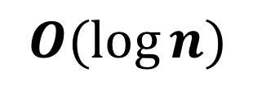
Some Examples
Determine the time complexity for the following algorithm.
count = 0;
for(i=1; i<N; i=i*2)
count++;
$$O(\log{n})$$

Slide 35
The Growth of Functions
Popular functions g(n) are
n log n, 1, 2^{n}, n², n!, n, n³, log n.
Listed from slowest to fastest growth:
• 1
• log n
• n
• n log n
• n²
• n³
• 2^{n}
• n!

Slide 36
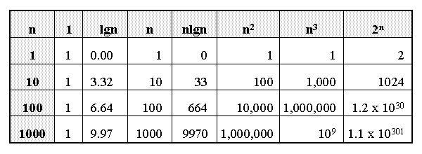
Growth of Functions

Slide 37
Comparing Growth Rates
n²
n log₂ n
2^{n}
n
T(n)
log₂ n
Problem Size

Slide 38
Thank You

